Slide 1




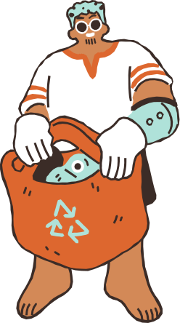
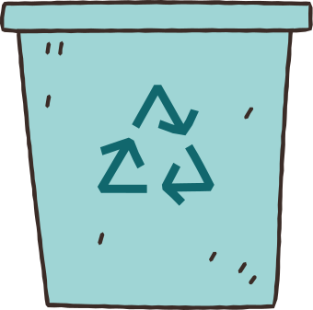
Nhóm 5
ECO EXCHANGE
Ê ! Let’s grow together !

Slide 2

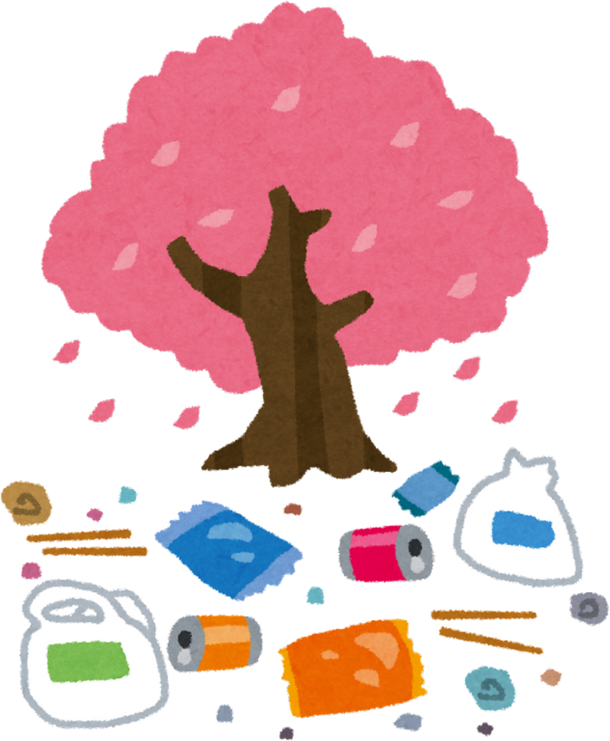

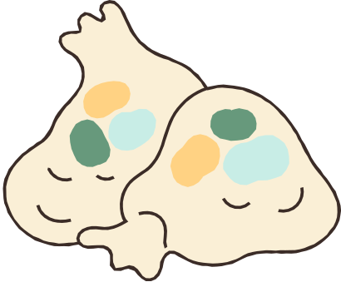
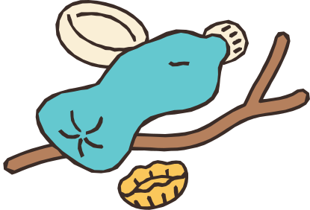
Environmental Problem
Plastic waste has existed for decades, continuously accumulating and spreading, yet there is still no effective solution to completely control it.
Its consequences are becoming increasingly severe, threatening the human living environment and ecosystems worldwide.
Plastic waste significantly impacts on ocean and terrestrial ecosystem, water source, the economic value of land and living area.

Slide 3
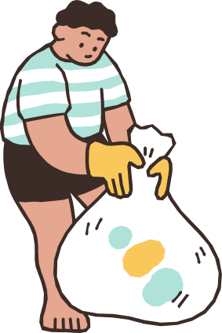
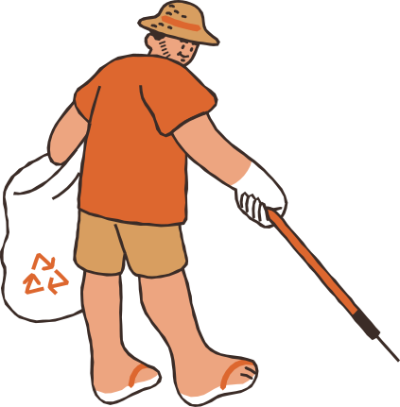
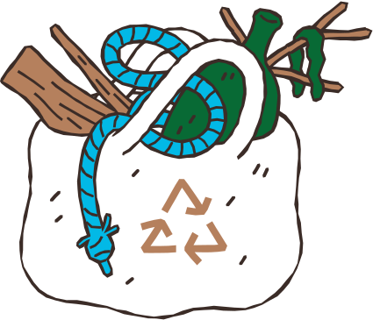
List of contents
I. Environmental Problem
II. Reason and Novelty
III. Key Activities
IV. Human Resources
V. Estimated Budget
VI. Risk Prediction

Slide 4




Reasons for EcoExchange
Lack of Awareness and Concrete Actions in Plastic Recycling
Lack of Information and Clear Guidance.
No Habit of Waste Sorting at the Source.
Plastic Recycling Hasn't Become a Daily Habit.
2. Promoting the "Returning Plastic Waste to the Source" Model
Reduce pressure on the waste management system.
Increase the efficiency of the recycling chain.
Encourage personal and corporate responsibility.
3. Spreading a Green Lifestyle in the Community
The spread of the green living movement.
The influence of the younger generation.
Promote more participation.

Slide 5





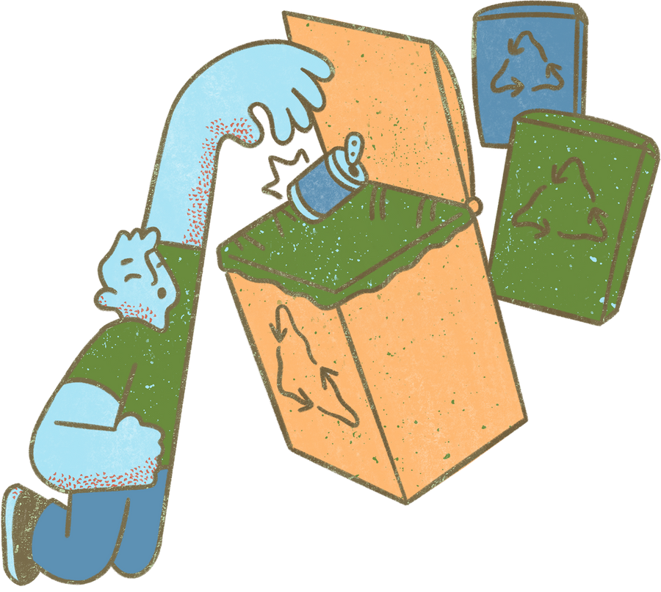
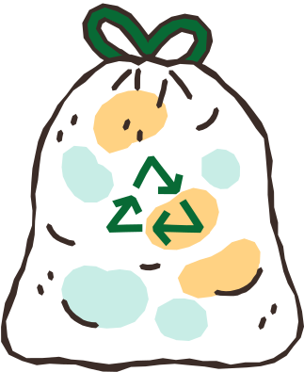
Novelty of
EcoExchange
Implement the "return plastic waste to source" model at universities.
Apply sorting machine models – A solution not yet widespread in Vietnam.
Organize monthly recycling workshops for students.

Slide 6

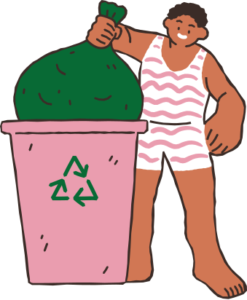
Project Aims
Raise awareness and promote action for environmental protection through Media contents, the Green Count Station, and Workshops.
Encouraging action: A convenient collection system for plastic bottles.
Creative Reuse: Turning waste into decorative crafts.
Sustainable Model: Recycling activities are integrated with economic benefits.
Witness the transformation of plastic waste into useful recycled products.

Slide 7

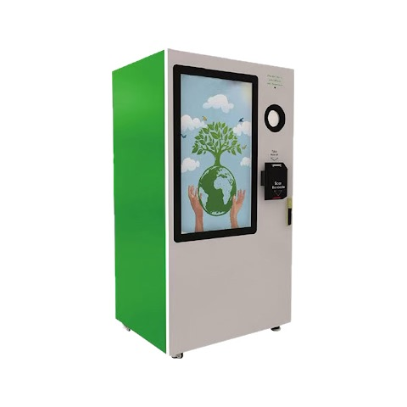
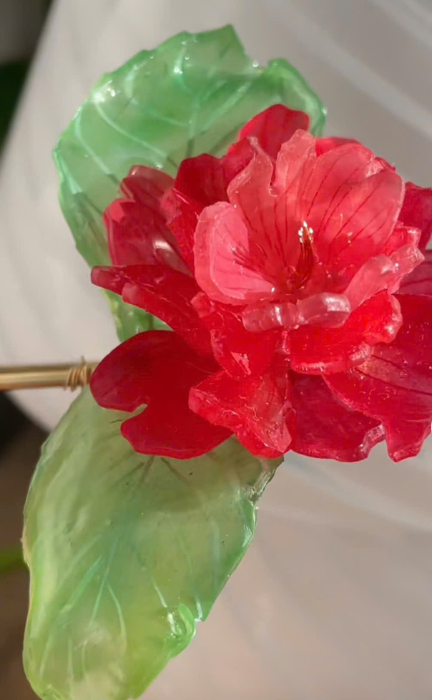
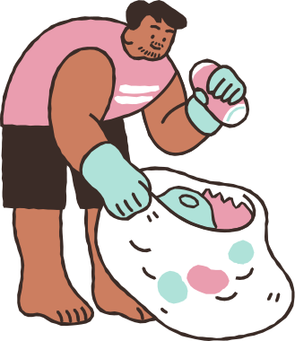
Key Activities
Media activities
The Green Counting Station
“Shrink” workshops
Handling process

Slide 8




Media Activities
Media fanpage:
+ Series of posts and videos: provide knowledge.
+ Call for action challenges: post pictures/ videos to recieve rewards.
+ Interactive minigames related to recycling.
+ Announcement for upcoming activites ( the Green Counting Station, workshops...)
Posters and media publications:
+ Place posters in the halls to emphasize the message of environmental protection and provide information about the campaign.
+ Provide QR code for quick access.
+ Create stickers/ postcards to attract student participation.

Slide 9
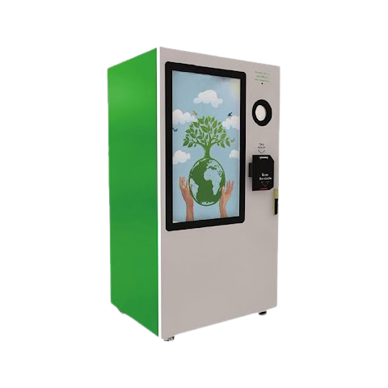



Máy Đếm Xanh
What is a “green counting station”?
This is a machine that collects used plastic bottles.
How does it works?
Scan a QR code to register/log in to our website.
Put the plastic bottles one by one into the machine.
The machine will automatically count the number of bottles.
Students can exchange the number of bottles for a voucher to participate in the workshops.

Slide 10



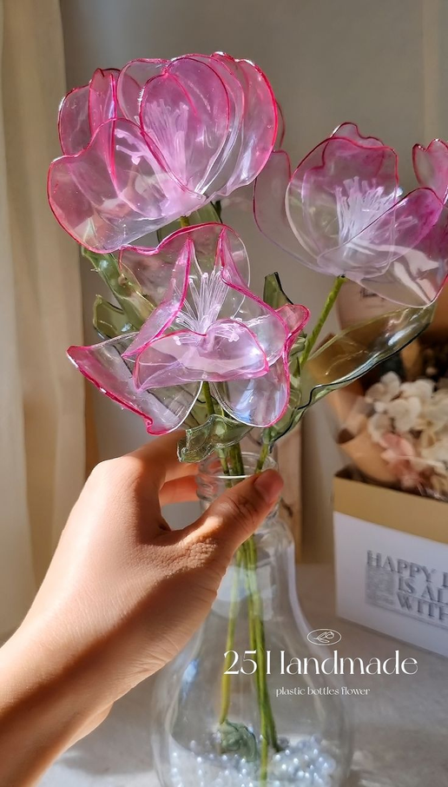


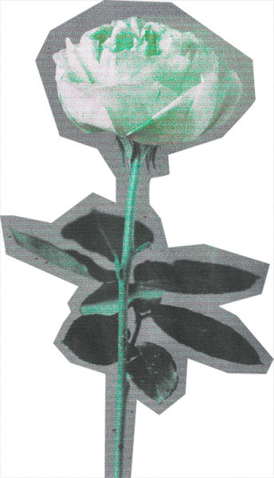



“Shrink” workshops
Materials: Use available revenue and other materials.
Staff: 6 main staff + 4 collaborators.
Phase 1: recycled flowers from collected plastic bottles
Use green wax tape and wrap around a stick to form the flower branch.
Cut the bottles into the shape of petals and pistils. Then use a lighter to round the edges.
Attach the petals and pistils to the flower branch.
Repeat the steps until you have an arbitrary number of flowers => bundle them into a bouquet.
shrink flower

Slide 11

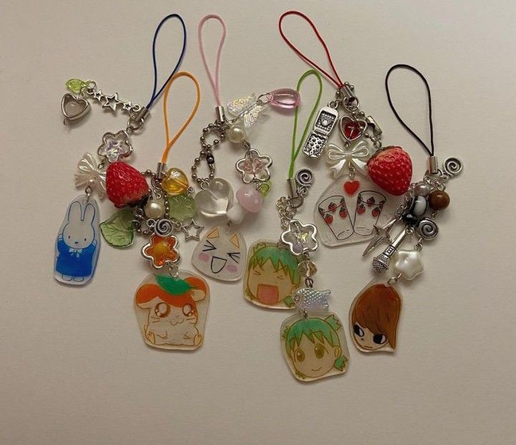


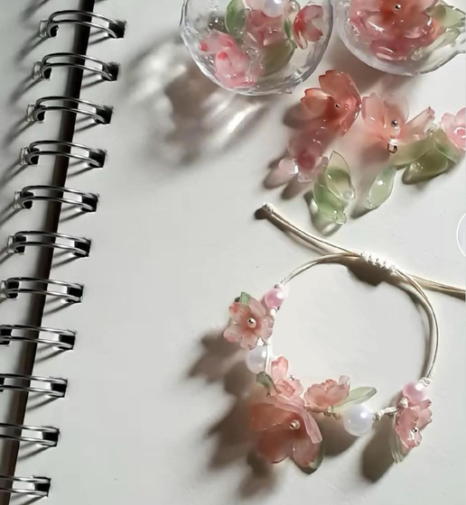
“Shrink” workshops
Materials: Use available revenue and other materials.
Staff: 6 main staff + 4 collaborators.
Phase 2: plastic keychains from shrink plastic
Participated students will be given an A4 sized shrink plastic sheet and a box of colored pencils. They can creatively choose the design.
After finishing the drawing -> cut out the drawn shape and punch holes to thread after heating the drawing.
attach the heated "charms" to the bracelets/keychains.
key chain

Slide 12
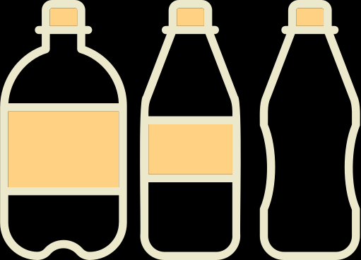

Handling process
The remaining plastic pieces after the workshop will be collected.
When the plastic bottles at the station are full, they will be taken by the staff to the temporary plastic bottle collection area.
A portion of the plastic bottles will be used for the workshop, and during the workshop, the "green counting stations" will continue working.
The remaining plastic bottles and plastic pieces used in the two workshops will be taken to the source for treatment through Grac's modern plastic waste collection model.

Slide 13
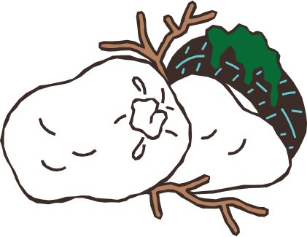
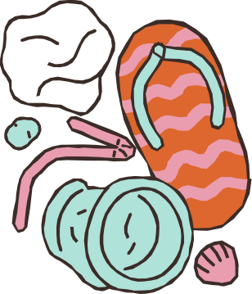

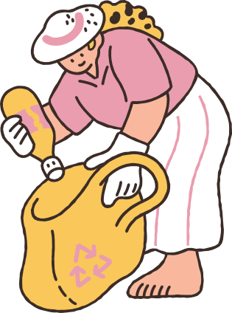
Human Resources
Place
University of Social Sciences and Humanities
VNUHCM or Student community center
Time:
First 2 weeks: Preparing tools, materials, goods,...
Next 2 weeks: Upload information about the plan to Media. Setting up the Station in the target place.
Day of Workshop: Sorting the waste from the Station, setting up Workshop,...
Last week: Transferring the leftover bottle to the recycle areas.

Slide 14
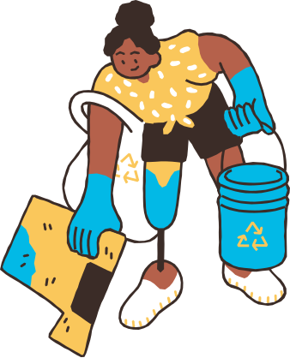


Human Resources
6 major members and 4 volunteers.
Tasks:
Maintaining website and station: 2 members.
Workshop: 10 members.
Checking & sorting plastic bottle: 2 members/Shifts.
Media: 4 members.
Main audience
Students.
Clubs and eco-organizations.
Lectures.
Government.

Slide 15

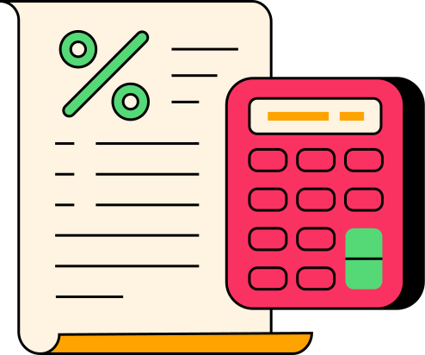
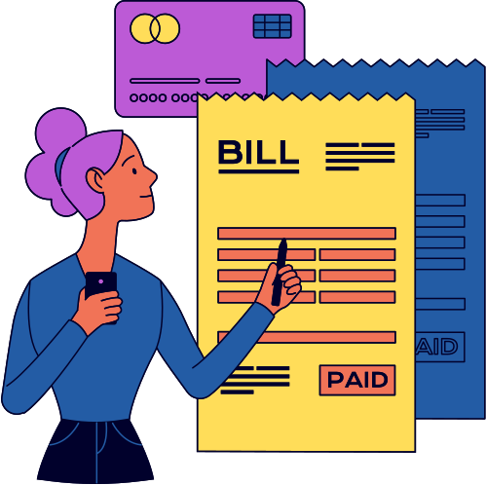
Estimated Budget
Workshop: ~706.000đ
The Green Counting Station: ~20.020.000đ
Media: ~1.500.000đ
Cost of risks ~1.000.000đ
Total: 23.226.000đ

Slide 16


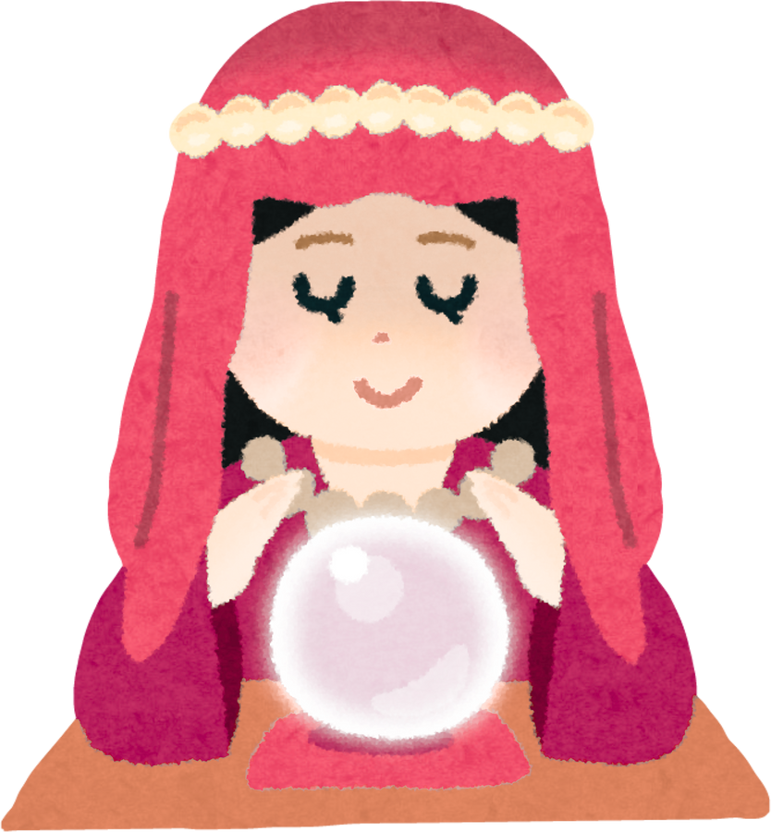
Risk Prediction
Polluted and incorrect kind of bottles.
Lack of public participation.
Safety in workshop.

Slide 17
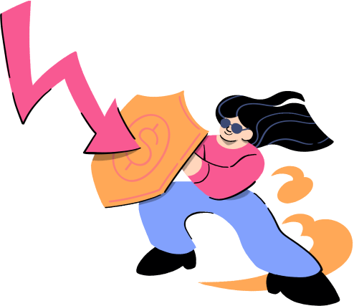

Risk Prevention Plan
RISKS | RISKS | SOLUTIONS | SOLUTIONS
Polluted and incorrect kind of bottles. | Polluted and incorrect kind of bottles. | Write instructions in the machine. Design poster, banner. Prepare a bin for removing waste. | Write instructions in the machine. Design poster, banner. Prepare a bin for removing waste.
Lack of public participation. | Lack of public participation. | Use trendy and latest concept. Explain clearly about the link between Dem Xanh. counterbot and Shrink workshop. | Use trendy and latest concept. Explain clearly about the link between Dem Xanh. counterbot and Shrink workshop.
Safety in workshop. | Safety in workshop. | Support participants with lighter and “máy khò”. Just use PET. Eliminating microplastics. | Support participants with lighter and “máy khò”. Just use PET. Eliminating microplastics.

Slide 18
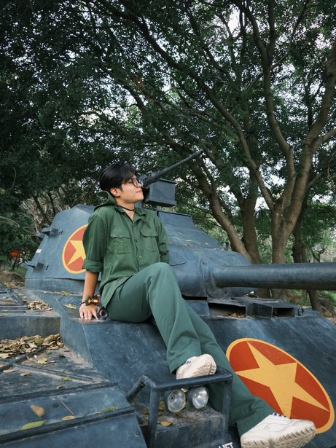
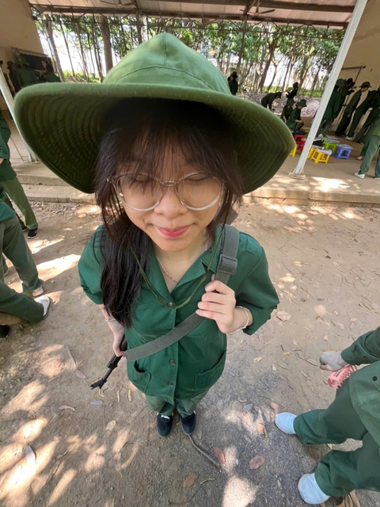
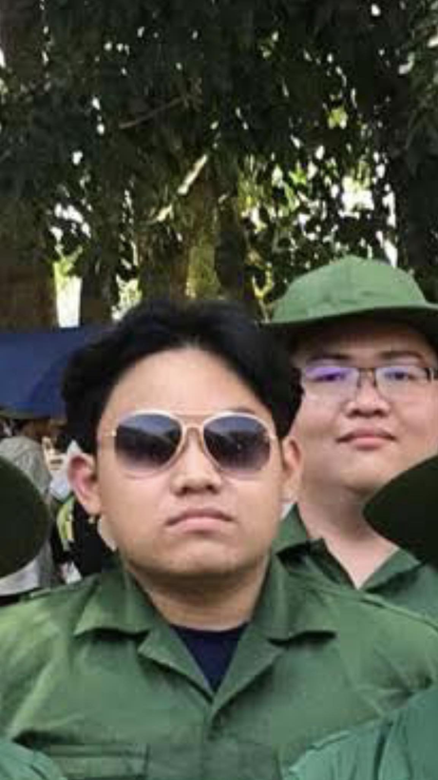

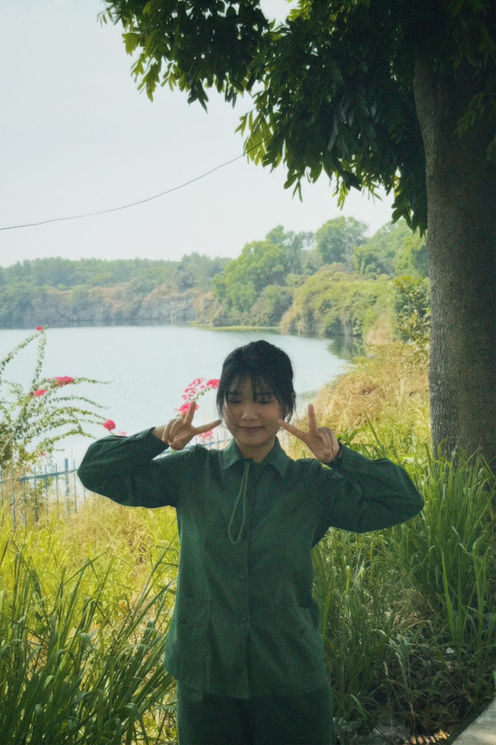

Members
Phan Tấn Nam
Trương Khánh Ngân
Võ Gia Long
Nhan Đức An
Đỗ Khánh Linh
Giang Thục Nghi

Slide 19
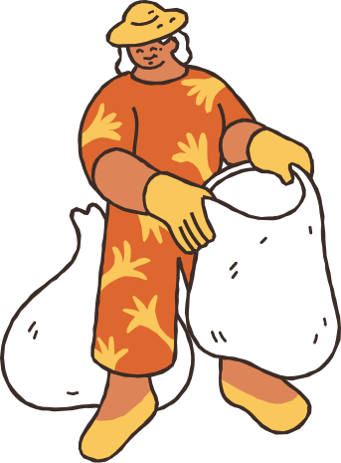
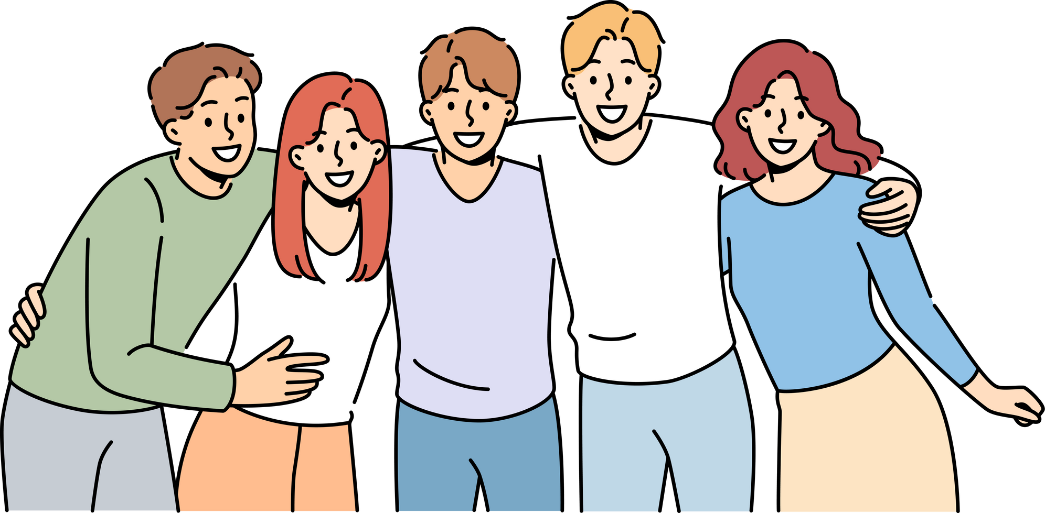
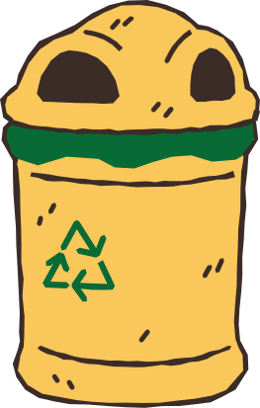
Thank you

